Slide 1


Epic Games
Epic's technology brings high-fidelity, interactive experiences to PC, console, mobile, AR, VR and the Web

Slide 2

About…
It’s an American video game and software development company. It’s based in Cary, North Carolina, USA. It’s was founded by Tim Sweeney as Potomac Computer Systems in 1991, originally located in his parents' house. It is the creator of Fortnite, Unreal Engine, Gears of War, Shadow Complex, and the Infinity Blade series of games.
Epic Games' headquarters in Cary, North Carolina

Slide 3
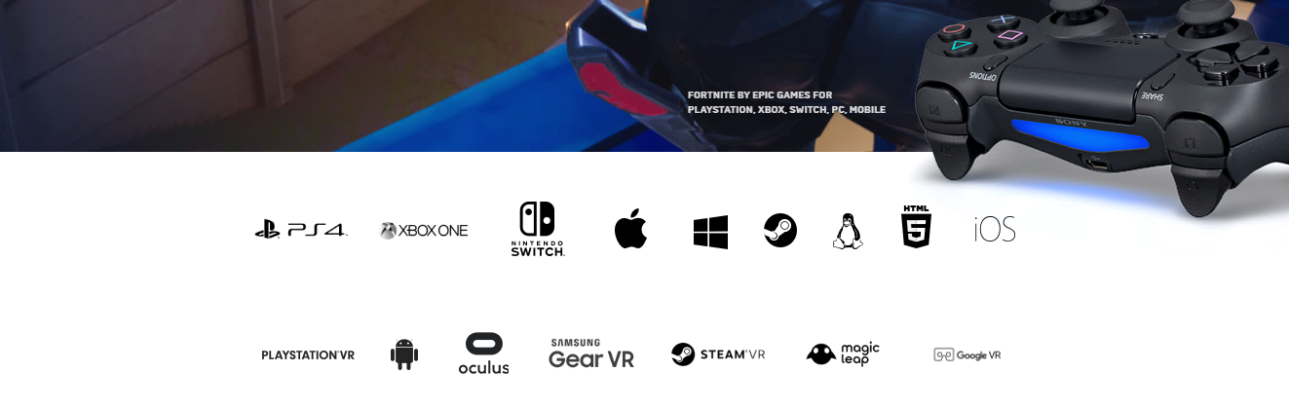
In 2014, Unreal Engine was named the “Most Successful Videogame Engine" by Guinness World Records.
From the launch of Fortnite in late 2017, the company value grew exponentially, and it’s now valued more than US$15 billion.

Slide 4

Founder :
Timothy D. Sweeney (born 1970) is an American video game programmer. He is known for being the founder and CEO of Epic Games and the creator of the Unreal Engine.
Sweeney was raised in Potomac, Maryland, the youngest of three brothers. At a young age he was interested in Electrical and Mechanical devices. Later he became interested in arcade games.
When 11, he had some of the first IBM personal computers.
Tim Sweeney

Slide 5
Sweeney attended the University of Maryland in mechanical engineering in 1989, though he was still fascinated by computers.
It required him to create a text editor based on the PASCAL language to be able to program the game, but this led to the idea of making a game out of the text editor itself.
In 2019, he was named Person of the Year by British magazine MCV.

Slide 6

Vice president :
For continued development, Sweeney sought out a business partner for Epic Megagames, eventually coming to MARK REIN, who had just been let go from ‘id Software’. Rein helped with growing and Managing the company.
Mark A. Rein is a Canadian entrepreneur and the vice president of Epic Games.
Mark A. Rein

Slide 7
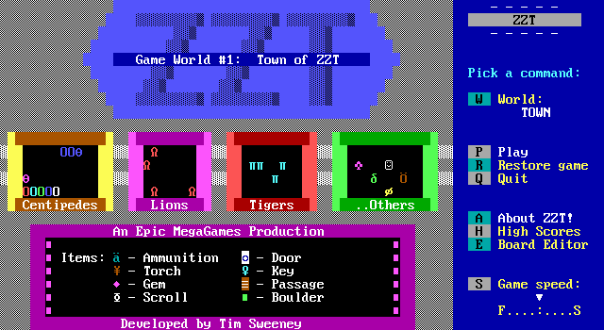
Potomac Computer Systems (1991–1992) It was founded by Tim Sweeney in 1991 when was studying mechanical engineering. After finishing his game ZZT ( action-adventure & puzzle video game ) in October 1991, he use the Potomac Computer Systems name to release the game to the public. The game was sold through bulletin board systems, while all orders were fulfilled by Sweeney's father, Paul Sweeney.
History…
Title screen of Episode 1

Slide 8



Epic MegaGames (1992–1999) In early 1992,Sweeney came up with name "Epic MegaGames", a name which incorporated "Epic" and "Mega" to make it sound like it represented a fairly large company, although he was its only employee! Later in the year the company grew to 30 employees consisting of programmers, artists, designers and composers. In 1998, Epic MegaGames released Unreal, a 3D first-person shooter co-developed with Digital Extremes, which expanded into a series of Unreal games.
The cover art for Unreal (1998 video game).

Slide 9

Epic Games (1999–2018)
In February 1999, they moved their headquarters to a new location in Cary, North Carolina, and would henceforth be known as simply Epic Games.
The move to North Carolina centralizes Epic, bringing all of the company's talented developers under one roof.
Around 2006,The company decided to shift focus into developing on console systems. Epic then released the Gears of War, which became a commercial success for the company, grossing about US$100 million off a US$12 million budget. It became one of the best-selling franchises for the Xbox 360.
The cover art for Gears of War

Slide 10

In 2012, Epic made an agreement with Tencent Games, who had several games under their banner (including League of Legends and PUBG) which are operating successfully as games as a service.
This provided them with the $330 million as investment in exchange for 40% of stocks and shares.
The investment allowed Epic Games to relicense the Unreal Engine 4 engine in March 2015 to be free for all.
In 2018, Epic received $1.25 billion in new funding from multiple investors, which marks the largest ever investment in a video game company.

Slide 11

“Computer graphics became powerful enough to make photorealistic images in real time,” said Epic CEO Tim Sweeney, a turning point that occurred a few years ago and opened up the possibilities for many more applications.

Slide 12


Slide 13

Epic Games’ Fortnite has 200 million users and has generated revenue reported at $1 billion. But its Unreal Engine, which powers many other games, is a key to recent $15 billion valuation. Unreal Engine, which has 7 million users from the game design, enterprise community, architecture to medicine and car manufacturing. In a way, the Unreal Engine is to Epic Games, what AWS is to Amazon.
Financing a $15 billion Company!

Slide 14

Epic takes a 5 percent cut of all gross revenue on applications (primarily games) created using the engine once they make $3,000 per quarter.
As an example, Epic is earning money from Fortnite’s main competitor, PUBG, developed by South Korea’s Bluehole using the Unreal Engine..

Slide 15
Products…

Slide 16







Video games… Epic Games is known for games such as ZZT developed by founder Tim Sweeney. It released Unreal game series, Unreal Tournament and various titles including Jazz Jackrabbit and Epic Pinball, the Gears of War series which is now owned by The Coalition and Microsoft Game Studios, Infinity Blade, Shadow Complex, Bulletstorm, and Fortnite.

Slide 17

Make Something Unreal
With the most powerful creation engine

Slide 18

Unreal Engine:
Epic made Unreal Game Engine, which has a complete feature set of graphical rendering, sound processing, and physics for developing games.
Unreal Engine is suitable for development tools made for anyone working with real-time technology.
From enterprise applications and cinematic experiences to high-quality games across PC, console, mobile, VR and AR.

Slide 19
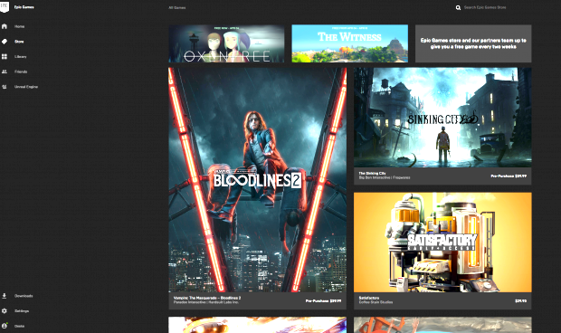
Epic Games store: Epic announced its own Epic Games Store, an open digital storefront for games. Differing from Valve's Steam storefront, which takes 30% of revenues from the sale of a game. The Epic Game Store takes 12%, as these lower revenue-sharing agreements will draw developers to Epic Store.

Slide 20

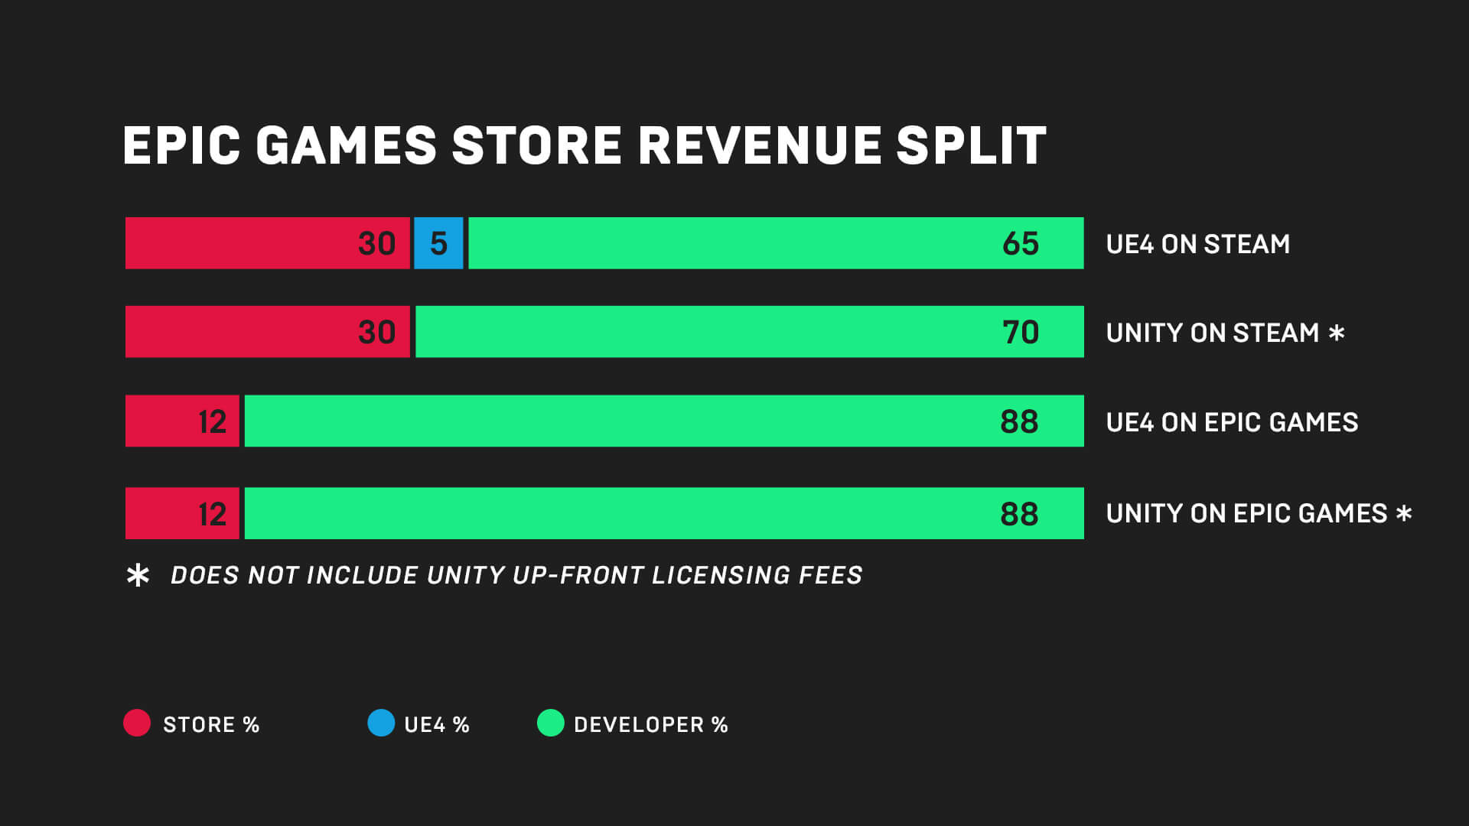
Partner with Creators:
Epic Games’ Support-A-Creator program connects you with over 10,000 content creators and influencers with millions of supporters.
More Revenue:
Keep 88% of the revenue from your games instead of 70%. If your game is built using Unreal Engine, Epic will cover your engine royalties on Epic Games store revenue.
Reach Players:
Connect with millions of players who are already in the Epic Games ecosystem.
More Control:
Own your game page, news feed and a direct relationship with your players.

Slide 21
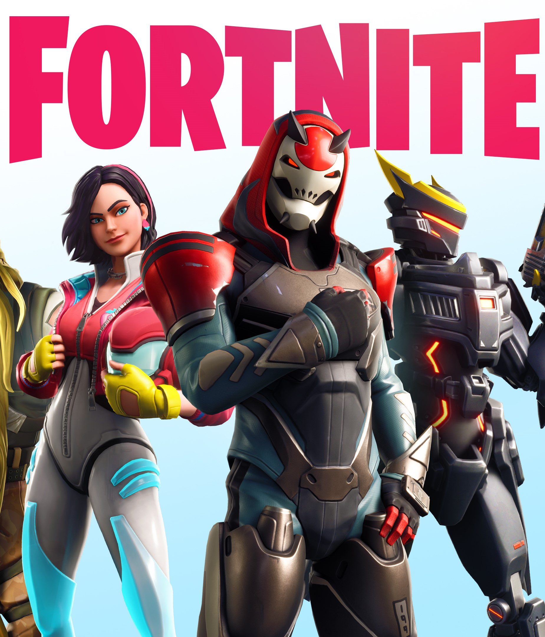
Following on the popularity of PUBG in 2017, Epic developed a variant of Fortnite called Fortnite Battle Royale, which was released in September 2017 as a free-to-play title on all platforms.
It quickly gained audience, having over 125 million players by May 2018 with estimates of having earned over US$1 billion in an Year after launch.

Slide 22

Player count continued to expand when Epic broke new ground by convincing Sony to allowing players on any device to compete with each other.
Fortnite has drawn nearly 250 million players as of March 2019.
Based on The financial success of Fortnite, Epic launched a US$100 million prize pool in February 2019 for Fortnite-related esports activities.
A scene from New York stadium during Fortnite World Cup in June 2019

Slide 23
Thank you.

